Slide 1
Computer Networking
Slide Set 2
Andrew W. Moore
Andrew.Moore@cl.cam.ac.uk

Slide 2
Topic 3.0: The Physical Layer
Our goals:
Understand physical channel fundamentals
Physical channels can carry data in proportion to the signal and inversely in proportion to noise
Modulation represents Digital data in analog channels
Baseband vs. Broadband
Synchronous vs. Asynchronous

Slide 3
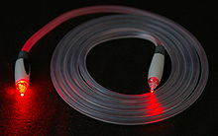
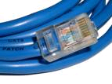
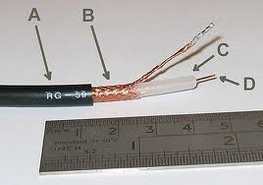
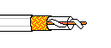

Physical Channels / The Physical Layer these example physical channels are also known as Physical Media
Twisted Pair (TP)
two insulated copper wires
Category 3: traditional phone wires, 10 Mbps Ethernet
Category 8: 25Gbps Ethernet
Shielded (STP)
Unshielded (UTP)
Coaxial cable:
two concentric copper conductors
bidirectional
baseband:
single channel on cable
legacy Ethernet
broadband:
multiple channels on cable
HFC (Hybrid Fiber Coax)
Fiber optic cable:
high-speed operation
point-to-point transmission
(10’s-100’s Gbps)
low error rate
immune to electromagnetic noise
Notes:
Twisted to cancel out the waves so the wire radiates less effectively.
Repeaters needed every 50km for fiber optics cable as opposed to 5km for copper

Slide 4
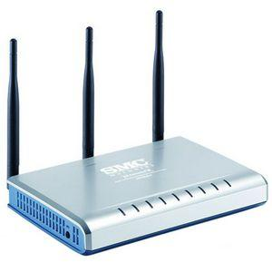
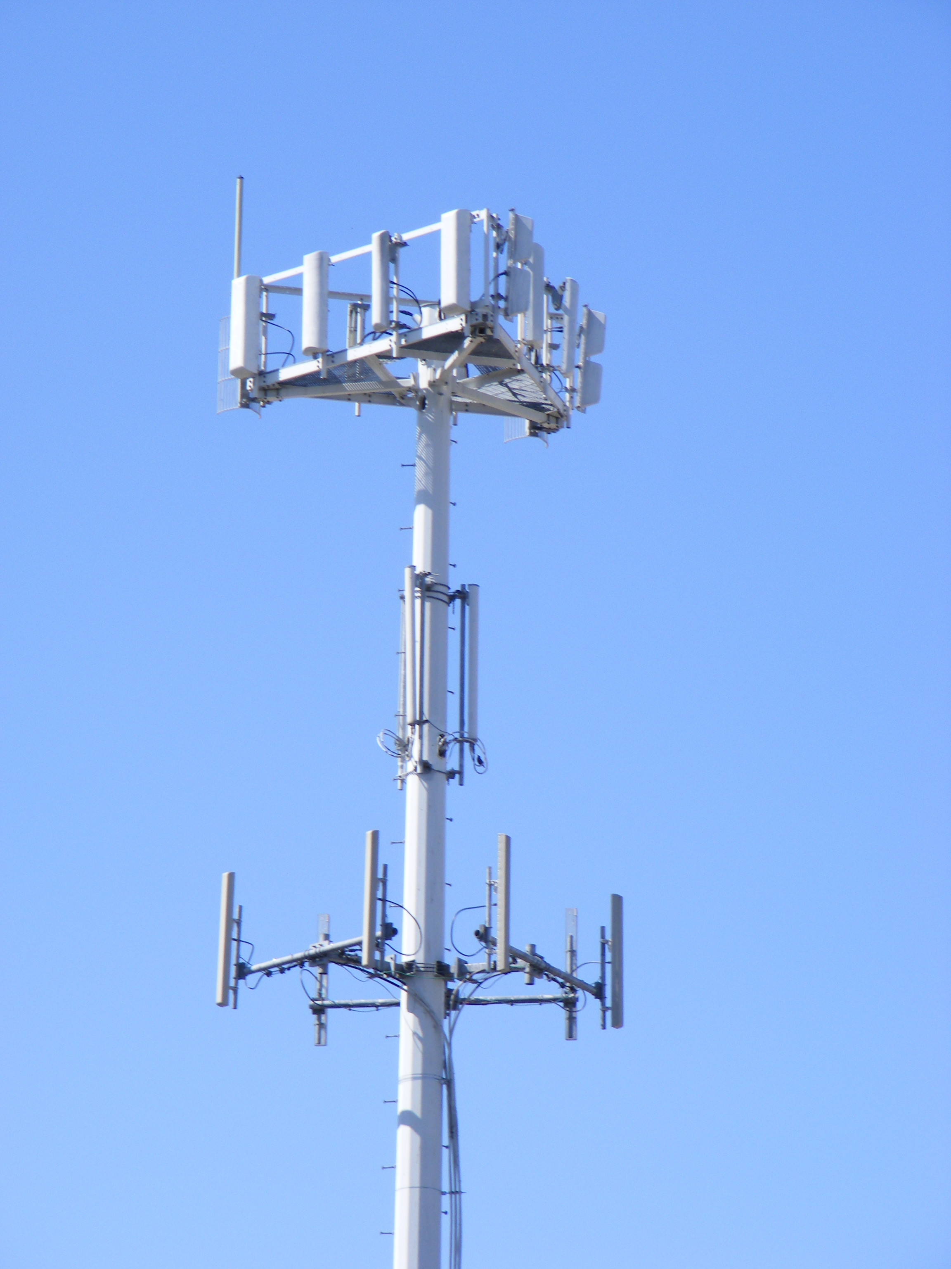
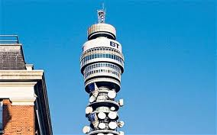
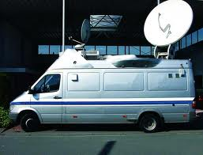
More Physical media: Radio
Bidirectional and multiple access
propagation environment effects:
reflection
obstruction by objects
interference
Radio link types:
terrestrial microwave
e.g. 90 Mbps channels
LAN (e.g., Wifi)
11Mbps, 54 Mbps, 600 Mbps
wide-area (e.g., cellular)
5G cellular: ~ 40 Mbps - 10Gbps
satellite
27-50MHz typical bandwidth
geosynchronous versus low altitude
For geosync - 270 msec end-end delay to orbit
Notes:
Think of the CHANNEL between entities.

Slide 5
Physical Channel Characteristics - Fundamental Limits -
symbol type: generally,
an analog waveform —
voltage, current, photo
intensity etc.
capacity: bandwidth
delay: speed of light in
medium and distance
travelled
fidelity: signal to noise
ratio
measure of the range of frequencies of sinusoidal signal that channel supports
E.g., a channel that supports sinusoids from 1 MHz to 1.1 MHz has a bandwidth of 100 KHz
“supports” in this context means “comes out the other end of the channel”
some frequencies supported better than others
analysing what happens to an arbitrary waveform is done by examining what happens to its component sinusoids → Fourier analysis
bandwidth is a resource

Slide 6
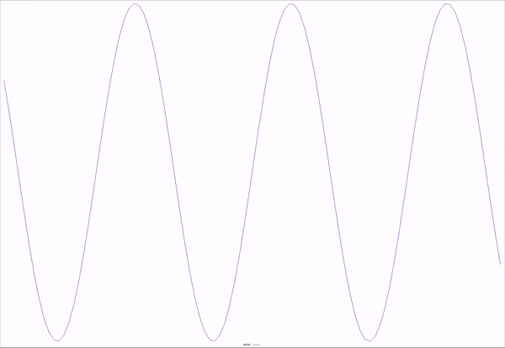
Analog meet Digital

Slide 7
Analog meet Digital
Square waves have high frequency components in them
Channels attenuate frequencies irregularly:
changing the shape of the signal
Receiver signal is related to the transmitted signal + noise
Noise may be systematic or random
Systematic noise from interfering equipment
can in principle be eliminated (not always convenient)
Random noise caused by thermal vibration (thermal noise)
“White” noise is evenly distributed across frequencies
signal to noise ratio S/N
more distance more noise

Slide 8
Noise: Enemy of Communications
Attenuation, External Noise, Systematic, non-systematic, digitization, interference, reflection, ….

Slide 9
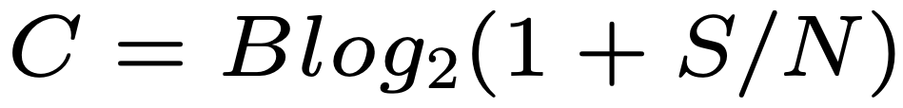
Bandwidth vs Signal to Noise
what’s better: high bandwidth or low signal to noise?
channels subject to white noise have information capacity C measured in bits per second, of a channel
B is the bandwidth of the channel S/N is the ratio of received signal power to received noise power.
channels with no noise have information capacity determined only by bandwidth
channels with any signal have nonzero information capacity
channels with signal to noise ratio of unity have an information capacity in bits per second equal to its bandwidth in hertz
(This is actually NOT the definition of information capacity; it is derived from the definition)

Slide 10
(Digital) Channels
Physical layer provides a channel
Fixed rate for now
Symbols are discrete values sent on the channel at fixed rate
Symbols need not be binary
Fidelity of the channel usually measured as a bit error rate — the probability that a bit sent as a 1 was interpreted as a 0 by the receiver or vice versa.
Baud rate is the rate at which symbols can be transmitted
Data rate (or bit rate) is the equivalent number of binary digits which can be sent
E.g., if symbols represent with rate R then the data rate is 2 × R.

Slide 11
Modulation
Two definitions:
Transform an information signal into a signal more appropriate for transmission on a physical medium
The systematic alteration of a carrier waveform by an information signal
In general, we mean the first here
(which encompasses the second).

Slide 12
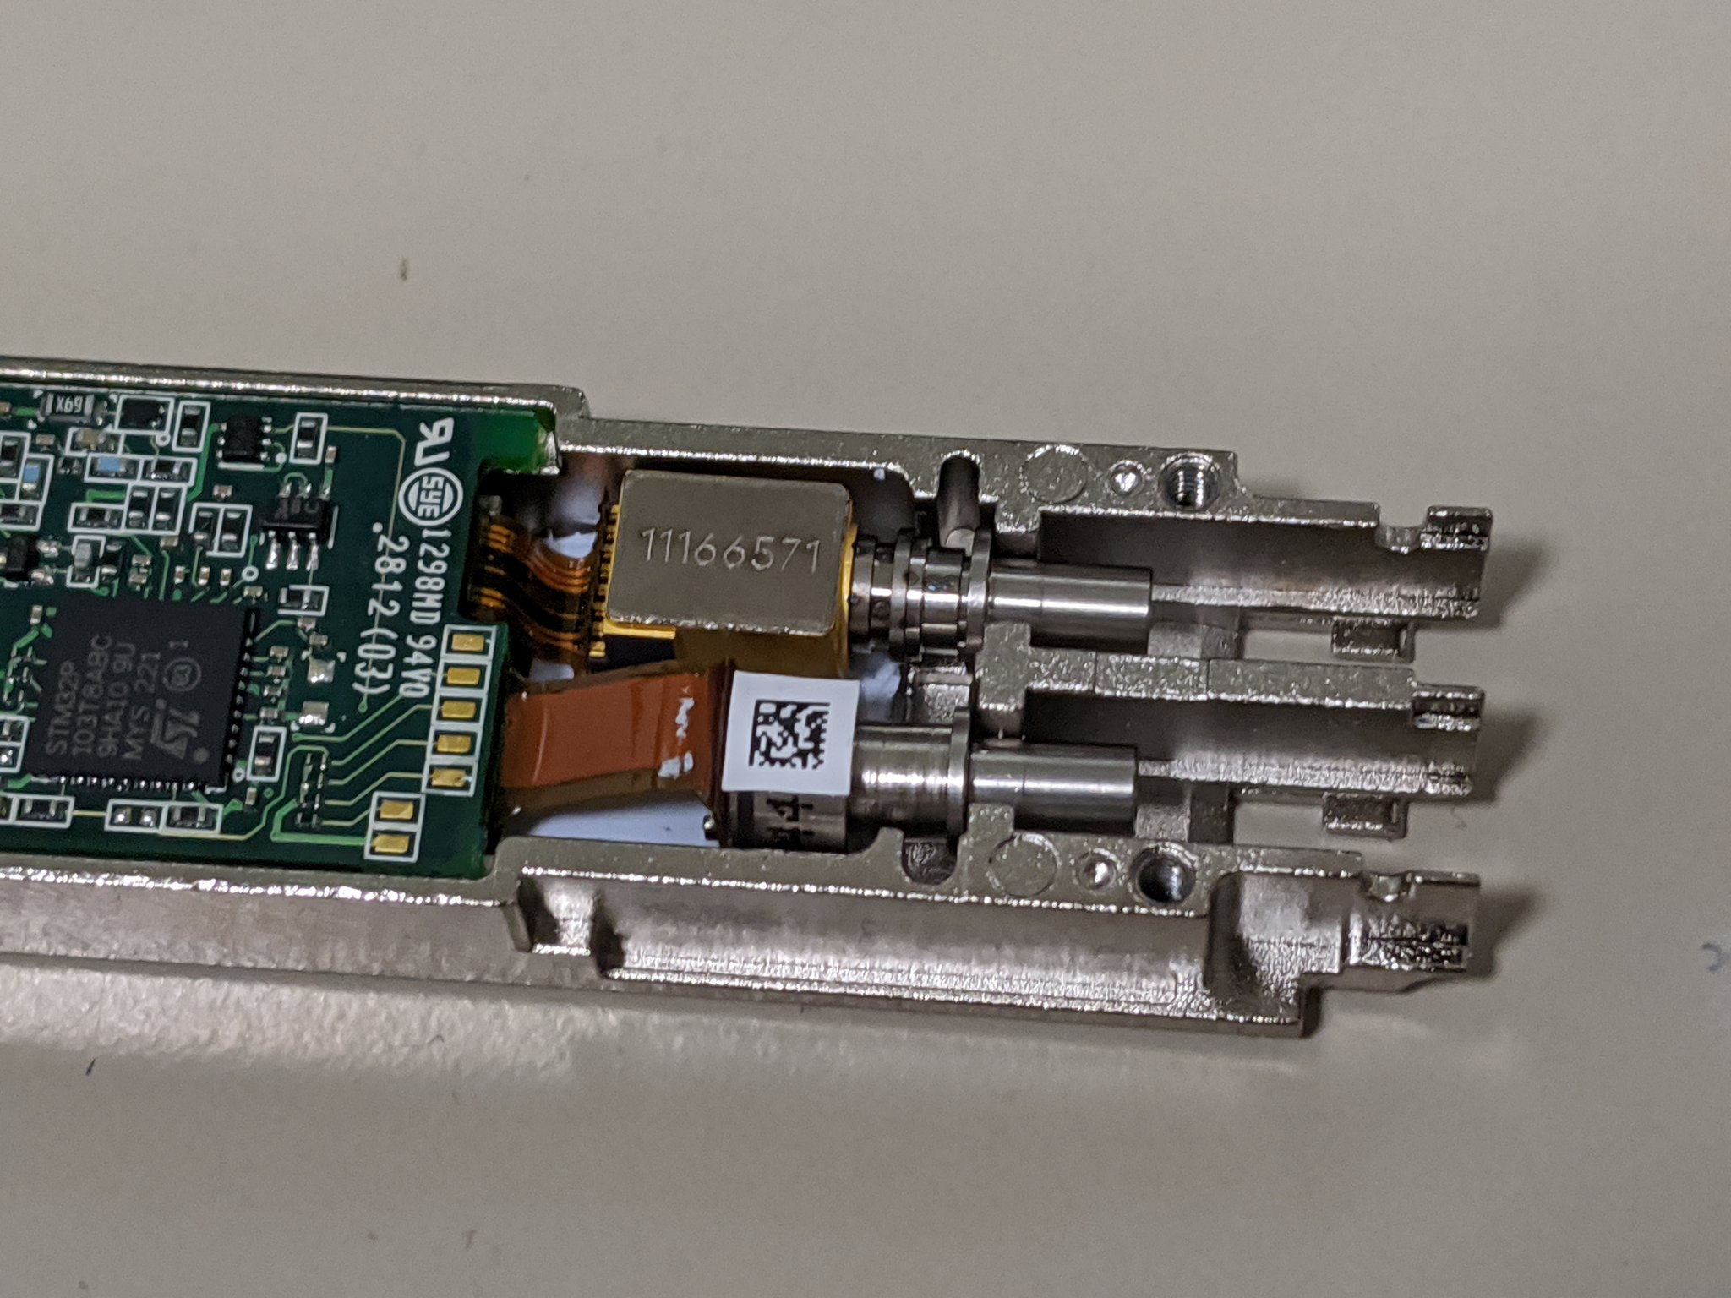

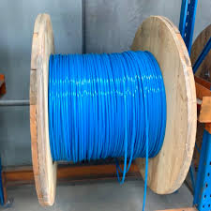
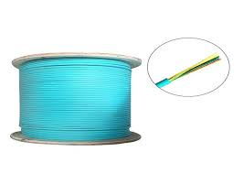


Slide 13
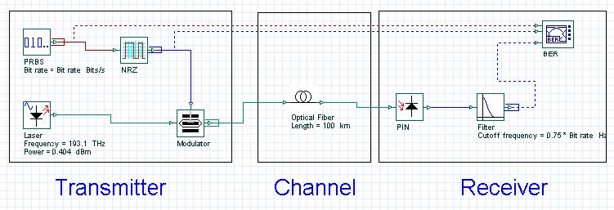
Communications

Slide 14
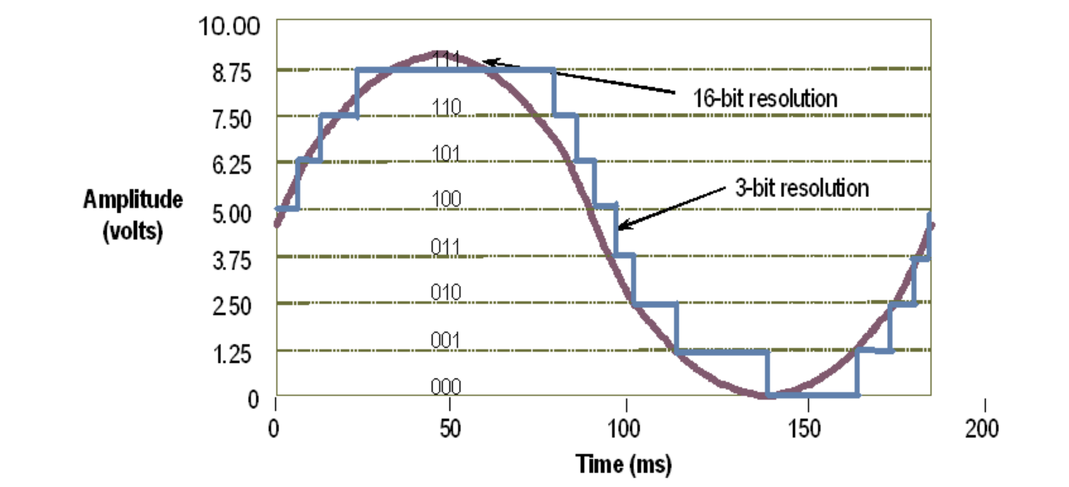
Analog/Digital Digital/Analog
Recall from Digital Electronics
Conversion errors can occur in both directions
e.g.
Noise leads to incorrect digitization
Insufficient digitization resolution leads to information loss
Notes:
AWM NOTE for 2022/23 More integration with DLL ffor physical coding

Slide 15
More Challenges
Where are the bits?
WHEN are the bits?
Bit boundaries can be asynchronous or synchronous

Slide 16
Asynchronous versus Synchronous
Transmission is sporadic, divided into frames
Receiver and transmitter have oscillators which are close in frequency producing tx clocks and rx clock
Receiver synchronises the phase of the rx clock with the tx clock by looking at one or more bit transitions
RX clock drifts with respect to the tx clock but stays within a fraction of a bit of tx clock throughout the duration of a frame
Transmission time is limited by accuracy of oscillators
Transmission is continuous
Receiver continually adjusts its frequency to track clock from incoming signal
Requires bit transitions to inform clock
Phase locked loop: rx clock predicts when incoming clock will change and corrects slightly when wrong.

Slide 17
Asynchronous versus Synchronous
Transmission is sporadic, divided into frames
Receiver and transmitter have oscillators which are close in frequency producing tx clocks and rx clock
Receiver synchronises the phase of the rx clock with the tx clock by looking at one or more bit transitions
RX clock drifts with respect to the tx clock but stays within a fraction of a bit of tx clock throughout the duration of a frame
Transmission time is limited by accuracy of oscillators
Transmission is continuous
Receiver continually adjusts its frequency to track clock from incoming signal
Requires bit transitions to inform clock
Phase locked loop: rx clock predicts when incoming clock will change and corrects slightly when wrong.
Bit transitions are critical

Slide 18
Coding – a channel function
Change the representation of data.
Encoding
Given Data
Changed Data
Decoding

Slide 19


MyPasswd
MyPasswd
AA$$$$ff
AA$$$$ff
AA$$$$ffff
AA$$$$ffff

Slide 20
Coding
Change the representation of data.
Encoding
Given Data
Changed Data
Decoding
Encryption: MyPasswd <-> AA$$$$ff
Error Detection: AA$$$$ff <-> AA$$$$ffff
Compression: AA$$$$ffff <-> A2$4f4
Analog: A2$4f4 <->

Slide 21
Line Coding Examples
where Baud=bit-rate
Non-Return-to-Zero (NRZ)
0
1
0
1
1
0
0
1
0
1
Non-Return-to-Zero-Mark (NRZM) 1 = transition 0 = no transition
0
1
0
1
1
0
0
1
0
1
Non-Return-to-Zero Inverted (NRZI) (note transitions on the 1)
0
1
0
1
1
0
0
1
0
1

Slide 22
Line Coding Examples
Non-Return-to-Zero (NRZ) (Baud = bit-rate)
0
1
0
0
1
0
0
1
1
1
Clock
Manchester example (Baud = 2 x bit-rate)
0
1
0
0
1
0
0
1
1
1
Clock
Quad-level code (2 x Baud = bit-rate)
0
1
0
0
1
0
0
1
1
1

Slide 23
Line Coding – Block Code example
Data to send
0
1
0
0
1
0
0
1
1
1
Line-(Wire) representation
0
1
0
1
0
1
0
0
1
1
Name 4b 5b Description
0 0000 11110 hex data 0
1 0001 01001 hex data 1
2 0010 10100 hex data 2
3 0011 10101 hex data 3
4 0100 01010 hex data 4
5 0101 01011 hex data 5
6 0110 01110 hex data 6
7 0111 01111 hex data 7
8 1000 10010 hex data 8
9 1001 10011 hex data 9
A 1010 10110 hex data A
B 1011 10111 hex data B
C 1100 11010 hex data C
D 1101 11011 hex data D
E 1110 11100 hex data E
F 1111 11101 hex data F
Name 4b 5b Description
Q -NONE- 00000 Quiet
I -NONE- 11111 Idle
J -NONE- 11000 SSD #1
K -NONE- 10001 SSD #2
T -NONE- 01101 ESD #1
R -NONE- 00111 ESD #2
H -NONE- 00100 Halt
Block coding transfers data with a fixed
overhead: 20% less information per Baud in the case of 4B/5B
So to send data at 100Mbps; the line rate
(the Baud rate) must be 125Mbps.
1Gbps uses an 8b/10b codec; encoding
entire bytes at a time but with 25% overhead

Slide 24

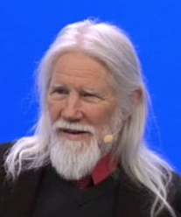
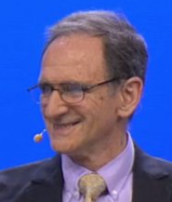
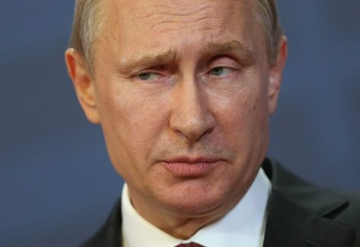
Line Coding Scrambling – with secrecy
Step 1
….G8wDFrB
EAFDSWbzQ7
BW2fbdTqeT
ImrukTYwQY
ndYdKb4….
Scrambling
Sequence
REPLICATE
SECURELY
Scrambling
Sequence
Step 2
DISTRIBUTE
SECURELY
Scrambling
Sequence
Scrambling
Sequence
Communications
Channel
Message
Message
Message
XOR
Sequence
Message
XOR
Sequence
Step 3
Don’t ever reuse Scrambling sequence, ever. <<< this is quite important
Whitfield Diffie
Martin Hellman

Slide 25
Line Coding Scrambling– no secrecy
Scrambling
Sequence
Scrambling
Sequence
Communications
Channel
Message
Message
Message
XOR
Sequence
Message
XOR
Sequence
e.g. (Self-synchronizing) scrambler
δ
δ
δ
δ
δ

Slide 26
Line Coding Examples (Hybrid)
…100111101101010001000101100111010001010010110101001001110101110100…
…10011110110101000101000101100111010001010010110101001001110101110100…
Inserted bits marking “start of frame/block/sequence”
Scramble / Transmit / Unscramble
δ
δ
δ
δ
δ
δ
δ
δ
δ
δ
…0100010110011101000101001011010100100111010111010010010111011101111000…
Identify (and remove) “start of frame/block/sequence”
This gives you the Byte-delineations for free
64b/66b combines a scrambler and a framer. The start of frame is a pair of bits 01 or 10: 01 means “this frame is data” 10 means “this frame contains data and control” – control could be configuration information, length of encoded data or simply “this line is idle” (no data at all)
Notes:
2020-1-29

Slide 27


Slide 30
Code Division Multiple Access (CDMA) (not to be confused with CSMA!)
used in several wireless broadcast channels (cellular, satellite, etc) standards
unique “code” assigned to each user; i.e., code set partitioning
all users share same frequency, but each user has own “chipping” sequence (i.e., code) to encode data
encoded signal = (original data) XOR (chipping sequence)
decoding: inner-product of encoded signal and chipping sequence
allows multiple users to “coexist” and transmit simultaneously with minimal interference (if codes are “orthogonal”)

Slide 31
CDMA Encode/Decode
channel output Z_{i,m}
Z_{i,m}= d_{i}.c_{m}
data
bits
d₀ = 1
1
1
1
1
1
d₁ = -1
1
1
1
-
-
-
-
1
-
-
-
1
-
1
1
1
1
1
sender
adds code
1
1
slot 1
channel
output
slot 0
channel
output
1
1
1
1
1
code
1
1
-
-
-
1
-
1
1
1
-
-
-
1
-
1
1
1
slot 1
slot 0
M
D_{i} = Σ Z_{i,m}.c_{m}
m=1
M
received
input
1
1
1
1
1
1
1
1
d₀ = 1
-
-
-
-
1
-
-
-
1
-
1
1
1
1
1
1
d₁ = -1
1
slot 1
channel
output
slot 0
channel
output
1
1
1
1
1
code
1
1
-
-
-
1
-
1
1
1
-
-
-
1
-
1
1
receiver
removes code
1
slot 1
slot 0

Slide 32
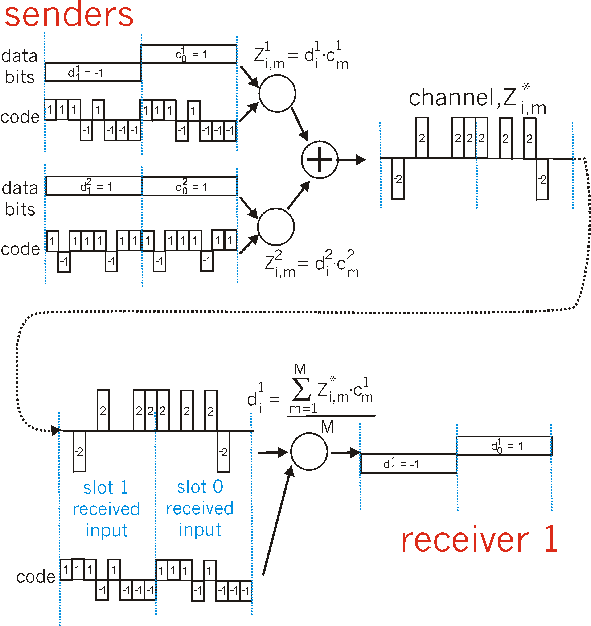
CDMA: two-sender interference
Each sender adds a unique
code
Sender one
removes
its unique
code
Notes:
27/1/23

Slide 33
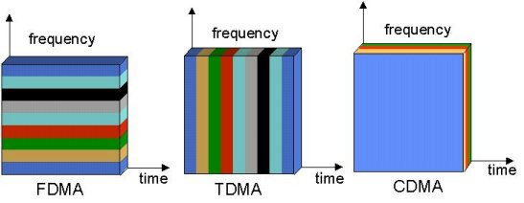
Multiple Access Mechanisms
Each dimension is orthogonal (so may be trivially combined)
Other dimensions are also available…
Notes:
polarization (Phase)
weird (electron spin)
CDMA too

Slide 34
Coding Examples summary
Common Wired coding
Block codecs: table-lookups
fixed overhead, inline control signals
Scramblers: shift registers
overhead free
Like earlier coding schemes and error correction/detection; you can combine these
e.g, 10Gb/s Ethernet may use a hybrid
CDMA (Code Division Multiple Access)
coping intelligently with competing sources
Mobile phones

Slide 35
Error Detection and Correction
Transmission media are not perfect and cause signal impairments:
Attenuation
Loss of energy to overcome medium’s resistance
Distortion
The signal changes its form or shape, caused in composite signals
Noise
Thermal noise, induced noise, crosstalk, impulse noise
Interference can change the shape or timing of a signal:
0 → 1 or 1 → 0

Slide 36

Error Detection and Correction
How to use coding to deal with errors in data communication?
Noise
0000
0000
0001
0000
Basic Idea :
Add additional information (redundancy) to a message.
Detect an error and discard
Or, fix an error in the received message.

Slide 37
Coding – a channel function
Change the representation of data.
Encoding
Given Data
Changed Data
Decoding

Slide 38
MyPasswd
MyPasswd
AA$$$$ff
AA$$$$ff
AA$$$$ffff
AA$$$$ffff

Slide 39
Coding Examples
Changig the representation of data.
Encoding
Given Data
Changed Data
Decoding
Encryption: MyPasswd <-> AA$$$$ff
Error Detection: AA$$$$ff <-> AA$$$$ffff
Compression: AA$$$$ffff <-> A2$4f4
Analog: A2$4f4 <->

Slide 40
Error Detection Code: Parity
Add one bit, such that the number of all 1’s is even.
Noise
0000
0
X
0001
0
0001
1
✓
0001
1
1001
0
✓
1111
0
Problem: This simple parity cannot detect two-bit errors.
Notes:
A redundant bit, parity bit, is appended to every data unit st that the total number of 1s (including the parity bit) becomes even
Parity can detect single-bit errors.
It can detect burst errors only if the total number of errors in each data is odd.

Slide 41
Error Detection Code
Sender:
Y = generateCheckBit(X);
send(XY);
Receiver:
receive(X1Y1);
Y2=generateCheckBit(X1);
if (Y1 != Y2) ERROR;
else NOERROR
Noise
==
Notes:
2 feb 2022

Slide 42
Error Detection Code: CRC
CRC means “Cyclic Redundancy Check”.
“A sequence of redundant bits, called CRC, is appended to the end of data so that the resulting data becomes exactly divisible by a second, predetermined binary number.”
CRC:= remainder (data÷ predetermined divisor)
More powerful than parity.
It can detect various kinds of errors, including 2-bit errors.
More complex: multiplication, binary division.
Parameterized by n-bit divisor P.
Example: 3-bit divisor 101.
Choosing good P is crucial.
Notes:
All single-bit errors, as long as the (x^{k}) and (x^{0}) terms have nonzero coefficients
All double-bit errors, as long as (C(x)) has a factor with at least three terms
Any odd number of errors, as long as (C(x)) contains the factor ((x + 1))

Slide 43
CRC with 3-bit Divisor 101
1111
00
0
1001
11
0
CRC
Parity
1111000
same check bits from Parity,
but different ones from CRC
1001000
Multiplication by 2³
D2 = D * 2³
Binary Division by 101
CheckBit = (D2) rem (101)
Add three 0’s at the end
Kurose p478 §5.2.3
Peterson URL §2.4

Slide 44
Error Detection Code
Sender:
Y = generateCRC(X div P);
send(X);
send(Y);
Receiver:
receive(X1);
receive(Y1);
Y2=generateCRC(X1Y1 div P);
if (Y2 != 0s) ERROR;
else NOERROR
Noise
0s ==

Slide 45
Transforming Error Detection to…
Sender:
Y = generateCheckBit(X);
send(XY);
Receiver:
receive(X1Y1);
Y2=generateCheckBit(X1);
if (Y1 != Y2) ERROR;
else NOERROR
Noise
==

Slide 46
Forward Error Correction (FEC)
Sender:
Y = generateCheckBit(X);
send(XY);
Receiver:
receive(X1Y1);
Y2=generateCheckBit(X1);
if (Y1 != Y2) FIXERROR(X1Y1);
else NOERROR
Noise
!=

Slide 47
Forward Error Correction (FEC)
Sender:
Y = generateCheckBit(X);
send(XY);
Receiver:
receive(X1Y1);
Y2=generateCheckBit(X1);
if (Y1 != Y2) FIXERROR(X1Y1);
else NOERROR
Noise
==

Slide 48
Basic Idea of Forward Error Correction
Replace erroneous data
by its “closest” error-free data.
Good
Good
00
000
10
101
3
2
Bad
Bad
Bad
11
101
01
000
10
110
4
01
011
1
11
110
Good
Good
Notes:
2020-1-31

Slide 49
Error Detection vs Correction
Error Correction:
Cons: More check bits. False recovery.
Pros: No need to re-send.
Error Detection:
Cons: Need to re-send.
Pros: Less check bits.
Usage:
Correction: A lot of noise. Expensive to re-send.
Detection: Less noise. Easy to re-send.
Can be used together.
FEC: Kurose&Ross P618 §7.3.3
No useful Peterson&Davie reference

Slide 50
Topic 3: The Data Link Layer
Our goals:
understand principles behind data link layer services:
(these are methods & mechanisms in your networking toolbox)
error detection, correction
sharing a broadcast channel: multiple access
link layer addressing
reliable data transfer, flow control
instantiation and implementation of various link layer technologies
Wired Ethernet (aka 802.3)
Wireless Ethernet (aka 802.11 WiFi)
Algorithms
Binary Exponential Back-off
Spanning Tree (Dijkstra)
General knowledge
Random numbers are important and hard

Slide 51

Link Layer: Introduction
Some reminder-terminology:
hosts and routers are nodes
communication channels that connect adjacent nodes along communication path are links
wired links
wireless links
LANs
layer-2 packet is a frame, encapsulates datagram
data-link layer has responsibility of
transferring datagram from one node
to adjacent node over a link

Slide 52
Link Layer (Channel) Services - 1/2
framing, physical addressing:
encapsulate datagram into frame, adding header, trailer
channel access if shared medium
“MAC” addresses used in frame headers to identify source, destination
This is not an IP address!
reliable delivery between adjacent nodes
we revisit this again in the Transport Topic
seldom used on low bit-error link (fiber, some twisted pair)
wireless links: high error rates

Slide 53
Link Layer (Channel) Services – 2/2
flow control:
pacing between adjacent sending and receiving nodes
error control:
error detection:
errors caused by signal attenuation, noise.
receiver detects presence of errors:
signals sender for retransmission or drops frame
error correction:
receiver identifies and corrects bit error(s) without resorting to retransmission
access control: half-duplex and full-duplex
with half duplex, nodes at both ends of link can transmit, but not at same time

Slide 54
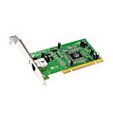
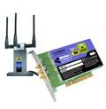
Where is the link layer implemented?
in each and every host
link layer implemented in “adaptor” (aka network interface card NIC)
Ethernet card, PCMCI card, 802.11 card
implements link, physical layer
attaches into host’s system buses
combination of hardware, software, firmware
host schematic
application
transport
network
link
cpu
memory
link
physical
host
bus
(e.g., PCI)
controller
physical
transmission
network adapter
card

Slide 55
Adaptors Communicating
datagram
datagram
controller
controller
sending host
receiving host
datagram
frame
sending side:
encapsulates datagram in frame
encodes data for the physical layer
adds error checking bits, provide reliability, flow control, etc.
receiving side
decodes data from the physical layer
looks for errors, provide reliability, flow control, etc
extracts datagram, passes to upper layer at receiving side

Slide 56

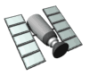
Multiple Access Links and Protocols
Two types of “links”:
point-to-point
point-to-point link between Ethernet switch and host
broadcast (shared wire or medium)
old-fashioned wired Ethernet (here be dinosaurs – extinct)
upstream HFC (Hybrid Fiber-Coax – the Coax may be broadcast)
Home plug / Powerline networking
802.11 wireless LAN
humans at a
cocktail party
(shared air, acoustical)
shared wire (e.g.,
Coax cabled Ethernet)
shared RF
(e.g., 802.11 WiFi)
shared RF
(satellite)

Slide 57
Multiple Access protocols
single shared broadcast channel
two or more simultaneous transmissions by nodes: interference
collision if node receives two or more signals at the same time
multiple access protocol
distributed algorithm that determines how nodes share channel, i.e., determine when node can transmit
communication about channel sharing must use channel itself!
no out-of-band channel for coordination

Slide 58
Ideal Multiple Access Protocol
Broadcast channel of rate R bps
1. when one node wants to transmit, it can send at rate R
2. when M nodes want to transmit,
each can send at average rate R/M
3. fully decentralized:
no special node to coordinate transmissions
no synchronization of clocks, slots
4. simple

Slide 59
MAC Protocols: a taxonomy
Three broad classes:
Channel Partitioning
divide channel into smaller “pieces” (time slots, frequency, code)
allocate piece to node for exclusive use
Random Access
channel not divided, allow collisions
“recover” from collisions
“Taking turns”
nodes take turns, but nodes with more to send can take longer turns

Slide 60
Channel Partitioning MAC protocols: TDMA (we discussed this earlier)
TDMA: time division multiple access
access to channel in "rounds"
each station gets fixed length slot (length = pkt trans time) in each round
unused slots go idle
example: station LAN, 1,3,4 have pkt, slots 2,5,6 idle
frame
1
3
4
1
3
4
6 slots

Slide 61
Channel Partitioning MAC protocols: FDMA (we discussed this earlier)
FDMA: frequency division multiple access
channel spectrum divided into frequency bands
each station assigned fixed frequency band
unused transmission time in frequency bands go idle
example: station LAN, 1,3,4 have pkt, frequency bands 2,5,6 idle
time
frequency bands
FDM cable

Slide 62
“Taking Turns” MAC protocols
channel partitioning MAC protocols:
share channel efficiently and fairly at high load
inefficient at low load: delay in channel access, 1/N bandwidth allocated even if only 1 active node!
random access MAC protocols:
efficient at low load: single node can fully utilize channel
high load: collision overhead
“taking turns” protocols:
look for best of both worlds!

Slide 63
“Taking Turns” MAC protocols
Polling:
Primary node “invites” subordinates nodes to transmit in turn
typically used with simpler subordinate devices
concerns:
polling overhead
latency
single point of failure (primary)
data
poll
primary
data
subordinates

Slide 64
“Taking Turns” MAC protocols
Token passing:
control token passed from one node to next sequentially.
token message
concerns:
token overhead
latency
single point of failure (token)
concerns fixed in part by a slotted ring (many simultaneous tokens)
T
(nothing
to send)
T
data

Slide 65
ATM
In TDM a sender may only use a pre-allocated slot
slot
frame
1
3
4
1
3
4
In ATM a sender transmits labeled cells whenever necessary
1
1
3
4
4
3
1
ATM = Asynchronous Transfer Mode – an ugly expression
think of it as ATDM – Asynchronous Time Division Multiplexing
That’s a variant of PACKET SWITCHING to the rest of us – just like Ethernet
but using fixed length slots/packets/cells
Use the media when you need it, but
ATM had virtual circuits and these needed setup….
Notes:
Worse ATM had an utterly irrational size

Slide 66
“Taking Turns” MAC protocols
channel partitioning MAC protocols:
share channel efficiently and fairly at high load
inefficient at low load: delay in channel access, 1/N bandwidth allocated even if only 1 active node!
random access MAC protocols:
efficient at low load: single node can fully utilize channel
high load: collision overhead
“taking turns” protocols:
look for best of both worlds!
Recall…..

Slide 67

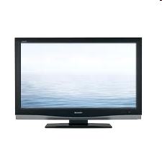


Cable access network: FDM, TDM and random access!
Internet frames, TV channels, control transmitted
downstream at different frequencies
cable headend
…
CMTS
…
splitter
cable
modem
ISP
cable modem
termination system
multiple downstream (broadcast) FDM channels: up to 1.6 Gbps/channel
single CMTS transmits into channels
multiple upstream channels (up to 1 Gbps/channel)
multiple access: all users contend (random access) for certain upstream channel time slots; others assigned TDM

Slide 68
Cable access network:
MAP frame for
Interval [t1, t2]
CMTS
Downstream channel i
Upstream channel j
cable headend
t₁
t₂
Residences with cable modems
Minislots containing
minislots request frames
Assigned minislots containing cable modem
upstream data frames
DOCSIS: data over cable service interface specification
FDM over upstream, downstream frequency channels
TDM upstream: some slots assigned, some have contention
downstream MAP frame: assigns upstream slots
request for upstream slots (and data) transmitted random access (binary backoff) in selected slots

Slide 69
Random Access MAC Protocols
When node has packet to send
Transmit at full channel data rate
No a priori coordination among nodes
Two or more transmitting nodes ⇒ collision
Data lost
Random access MAC protocol specifies:
How to detect collisions
How to recover from collisions
Examples
ALOHA and Slotted ALOHA
CSMA, CSMA/CD, CSMA/CA (wireless)

Slide 70
Key Ideas of Random Access
Carrier sense
Listen before speaking, and don’t interrupt
Checking if someone else is already sending data
… and waiting till the other node is done
Collision detection
If someone else starts talking at the same time, stop
Realizing when two nodes are transmitting at once
…by detecting that the data on the wire is garbled
Randomness
Don’t start talking again right away
Waiting for a random time before trying again

Slide 71
CSMA (Carrier Sense Multiple Access)
CSMA: listen before transmit
If channel sensed idle: transmit entire frame
If channel sensed busy, defer transmission
Human analogy: don’t interrupt others!
Does this eliminate all collisions?
No, because of nonzero propagation delay

Slide 72
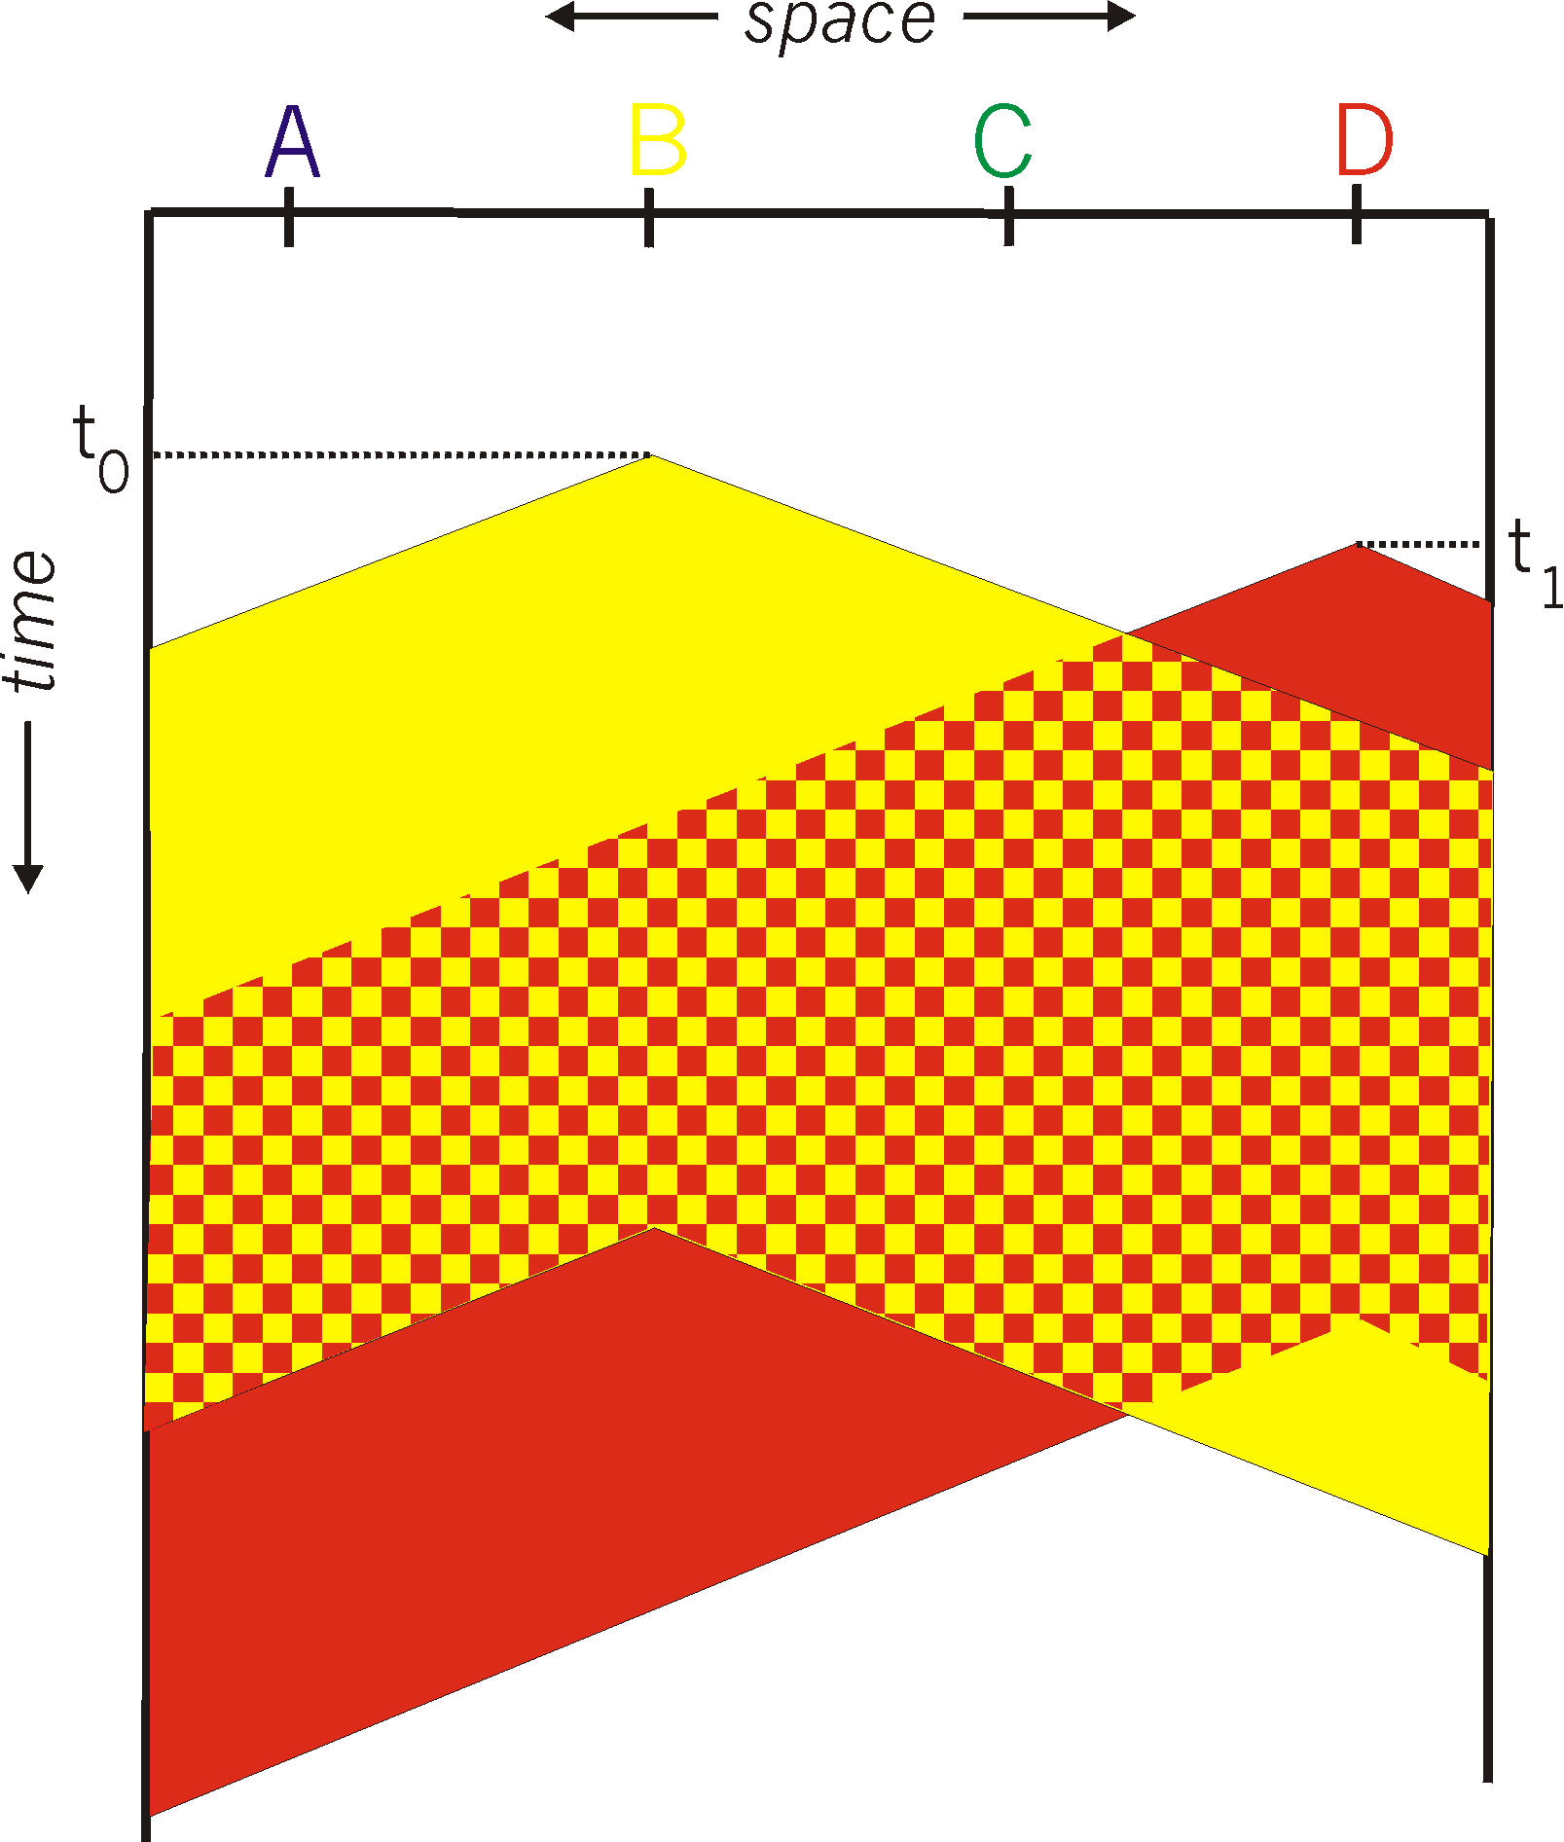
CSMA Collisions
Propagation delay: two nodes may not hear each other’s before sending.
Would slots hurt or help?
CSMA reduces but does not eliminate collisions
Biggest remaining problem?
Collisions still take full slot!
How do you fix that?
Notes:
2022-2-4

Slide 73
CSMA/CD (Collision Detection)
CSMA/CD: carrier sensing, deferral as in CSMA
Collisions detected within short time
Colliding transmissions aborted, reducing wastage
Collision detection easy in wired LANs:
Compare transmitted, received signals
Collision detection difficult in wireless LANs:
Reception shut off while transmitting (well, perhaps not)
Not perfect broadcast (limited range) so collisions local
Leads to use of collision avoidance instead (later)

Slide 74
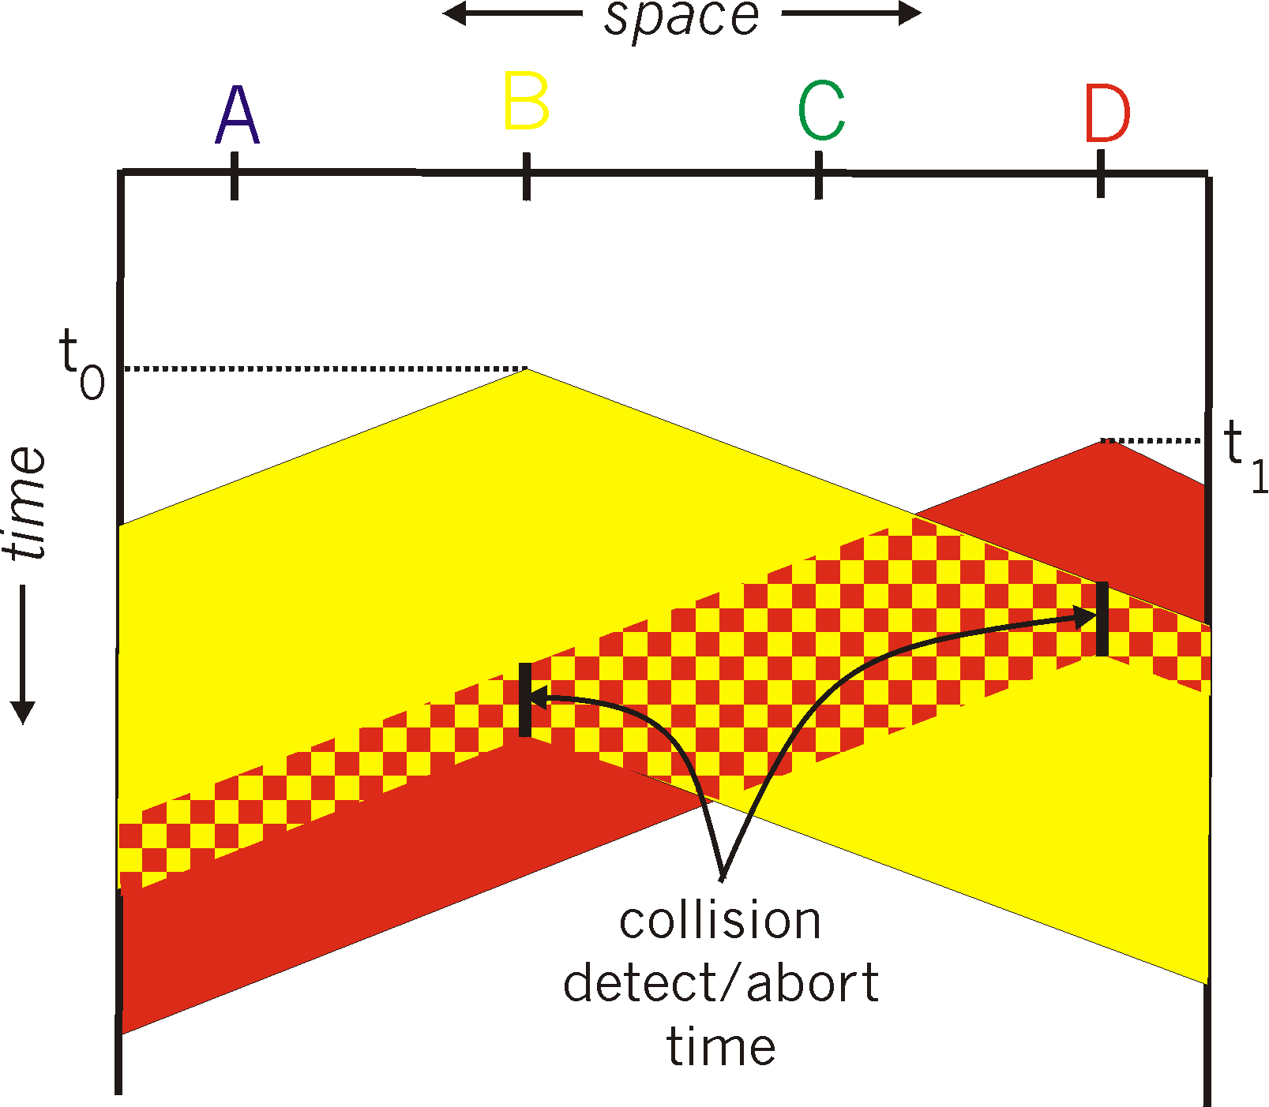

CSMA/CD Collision Detection
B and D can tell that collision occurred.
Note: for this to work, need restrictions on minimum frame size and maximum distance. Why?

Slide 75
Limits on CSMA/CD Network Length
A
B
latency d
Latency depends on physical length of link
Time to propagate a packet from one end to the other
Suppose A sends a packet at time t
And B sees an idle line at a time just before t+d
… so B happily starts transmitting a packet
B detects a collision, and sends jamming signal
But A can’t see collision until t+2d
Notes:
2020-2-3

Slide 76

Performance of CSMA/CD
Time wasted in collisions
Proportional to distance d
Time spend transmitting a packet
Packet length p divided by bandwidth b
Rough estimate for efficiency (K some constant)
Note:
For large packets, small distances, E ~ 1
As bandwidth increases, E decreases
That is why high-speed LANs are all switched aka packets are sent via a switch - (any d is bad)

Slide 77
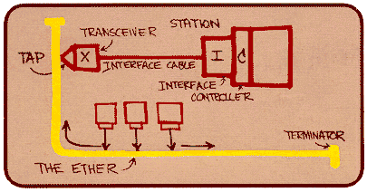
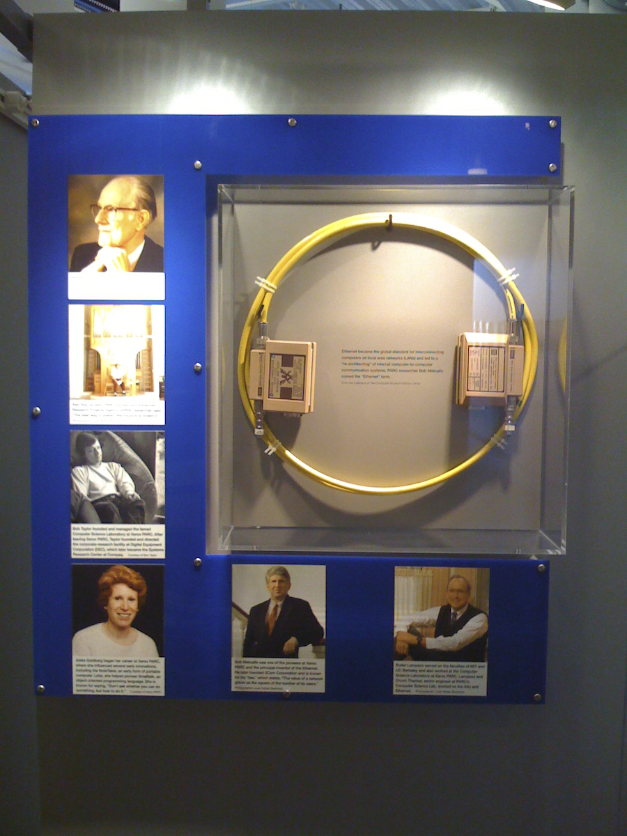
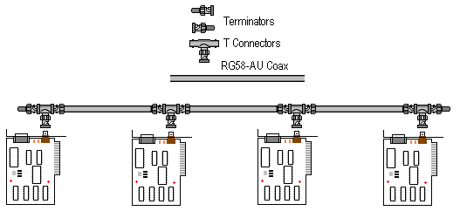
Ethernet… yet another product of XEROX/PARC

Slide 78
Ethernet: CSMA/CD Protocol
Carrier sense: wait for link to be idle
Collision detection: listen while transmitting
No collision: transmission is complete
Collision: abort transmission & send jam signal
Random access: binary exponential back-off
After collision, wait a random time before trying again
After m^{th} collision, choose K randomly from {0, …, 2^{m}-1}
… and wait for K*512 bit times before trying again
Using min packet size as “slot”
If transmission occurring when ready to send, wait until end of transmission (CSMA)
Notes:
30/1/22

Slide 79
Benefits of Ethernet
Easy to administer and maintain
Inexpensive
Increasingly higher speed
Evolvable!

Slide 80
Evolution of Ethernet
Changed everything except the frame format
From single coaxial cable to hub-based star
From shared media to switches
From electrical signaling to optical
Lesson #1
The right interface can accommodate many changes
Implementation is hidden behind interface
Lesson #2
Really hard to displace the dominant technology
Slight performance improvements are not enough

Slide 81
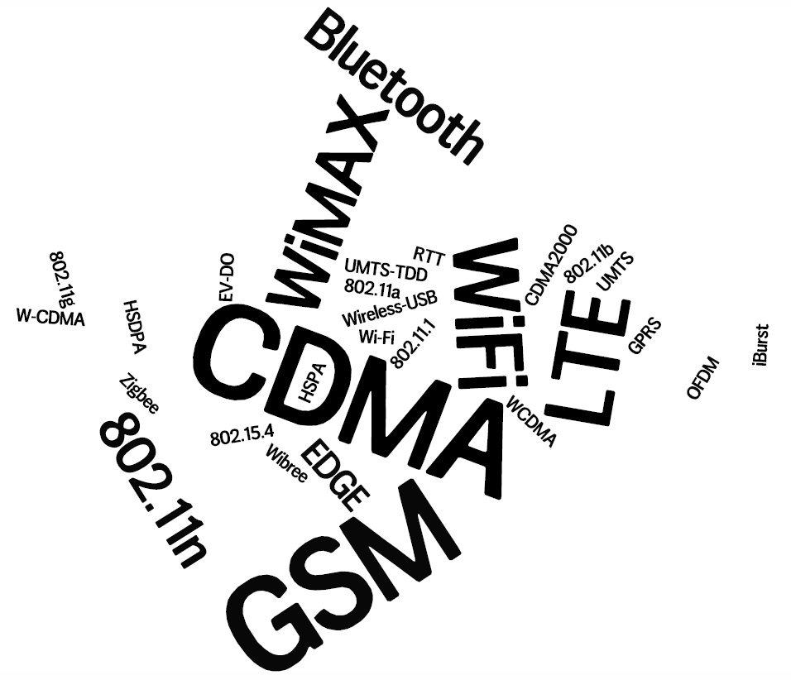
5G
4G
6G
Notes:
Rapid evolution in the wireless eco-system – hard to keep up
With either technologies or business-models

Slide 82
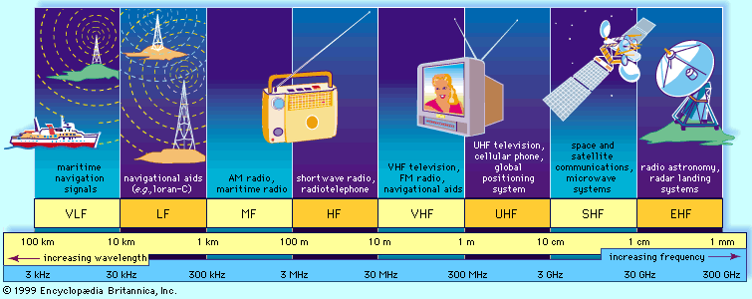
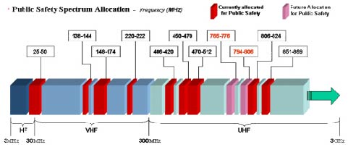
The Wireless Spectrum
Notes:
FCC allocates spectrum to users – who are these?
Govt. itself (various agencies), military.
Public-safety.
Broadcasters
Telecommunications providers (aka operators) – license holders.
Different bands behave differently …
Most wave propagation properties are frequency/wave-length dependent:

Slide 83
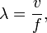
Metrics for evaluation / comparison of wireless technologies
Bitrate or Bandwidth
Range - PAN, LAN, MAN, WAN
Two-way / One-way
Multi-Access / Point-to-Point
Digital / Analog
Applications and industries
Frequency – Affects most physical properties: Distance (free-space loss) Penetration, Reflection, Absorption Energy proportionality Policy: Licensed / Deregulated
Line of Sight (Fresnel zone)
Size of antenna
Determined by wavelength – )
Notes:
Bitrate or Bandwidth
Range - PAN, LAN, MAN, WAN
Two-way / One-way
Multi-Access / Point-to-Point
Digital / Analog
Applications and industries
Frequency – Affects most physical properties: Distance (free-space loss) Penetration, Reflection, Absorption Energy proportionality Policy: Licensed / Deregulated
Line of Sight (Fresnel zone)
Size of antenna
(determined by wavelength – )

Slide 84
Wireless Communication Standards
Cellular (800/900/1700/1800/1900Mhz):
2G: GSM / CDMA / GPRS /EDGE
3G: CDMA2000/UMTS/HSDPA/EVDO
4G: LTE, WiMax
IEEE 802.11 (aka WiFi): (some examples)
b: 2.4Ghz band, 11Mbps (~4.5 Mbps operating rate)
g: 2.4Ghz, 54-108Mbps (~19 Mbps operating rate)
a: 5.0Ghz band, 54-108Mbps (~25 Mbps operating rate)
n: 2.4/5Ghz, 150-600Mbps (4x4 mimo)
ac: 2.4/5Ghz, 433-1300Mbps (improved coding 256-QAM)
ad: 60Ghz, 7Gbps
af: 54/790Mhz, 26-35Mbps (TV whitespace)
IEEE 802.15 – lower power wireless:
802.15.1: 2.4Ghz, 2.1 Mbps (Bluetooth)
802.15.4: 2.4Ghz, 250 Kbps (Sensor Networks)

Slide 85
What Makes Wireless Different?
Broadcast and multi-access medium…
err, so….
BUT, Signals sent by sender don’t always end up at receiver intact
Complicated physics involved, which we won’t discuss
But what can go wrong?

Slide 86
Lets focus on 802.11
aka - WiFi …
What makes it special?
Deregulation > Innovation > Adoption > Lower cost = Ubiquitous technology
JUST LIKE ETHERNET – not lovely but sufficient
Notes:
86

Slide 87
IEEE 802.11 Wireless LAN
IEEE 802.11 standard | Year | Max data rate | Range | Frequency
802.11b | 1999 | 11 Mbps | 30 m | 2.4 Ghz
802.11g | 2003 | 54 Mbps | 30m | 2.4 Ghz
802.11n (WiFi 4) | 2009 | 600 | 70m | 2.4, 5 Ghz
802.11ac (WiFi 5) | 2013 | 3.47Gpbs | 70m | 5 Ghz
802.11ax (WiFi 6) | 2020 (exp.) | 14 Gbps | 70m | 2.4, 5 Ghz
802.11af | 2014 | 35 – 560 Mbps | 1 Km | unused TV bands (54-790 MHz)
802.11ah | 2017 | 347Mbps | 1 Km | 900 Mhz
all use CSMA/CA for multiple access, and have base-station and ad-hoc network versions

Slide 88
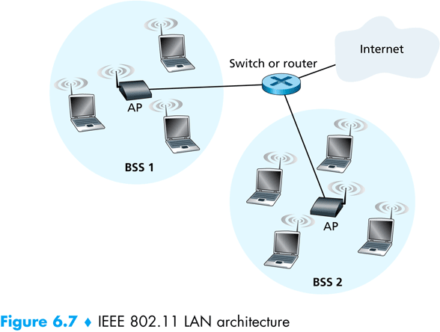
802.11 Architecture
Designed for limited area
AP’s (Access Points) set to specific channel
Broadcast beacon messages with SSID (Service Set Identifier) and MAC Address periodically
Hosts scan all the channels to discover the AP’s
Host associates with AP
802.11 frames exchanges
802.3 (Ethernet) frames exchanged

Slide 89
Wireless Multiple Access Technique?
Carrier Sense?
Sender can listen before sending
What does that tell the sender?
Collision Detection?
Where do collisions occur?
How can you detect them?

Slide 90
Hidden Terminals
A
B
C
transmit range
A and C can both send to B but can’t hear each other
A is a hidden terminal for C and vice versa
Carrier Sense will be ineffective
Notes:
90

Slide 91
Exposed Terminals
Exposed node: B sends a packet to A; C hears this and decides not to send a packet to D (despite the fact that this will not cause interference)!
Carrier sense would prevent a successful transmission.
A
B
C
D
Notes:
91

Slide 92
Key Points
No concept of a global collision
Different receivers hear different signals
Different senders reach different receivers
Collisions are at receiver, not sender
Only care if receiver can hear the sender clearly
It does not matter if sender can hear someone else
As long as that signal does not interfere with receiver
Goal of protocol:
Detect if receiver can hear sender
Tell senders who might interfere with receiver to shut up

Slide 93
Basic Collision Avoidance
Since can’t detect collisions, we try to avoid them
Carrier sense:
When medium busy, choose random interval
Wait that many idle timeslots to pass before sending
When a collision is inferred, retransmit with binary exponential backoff (like Ethernet)
Use ACK from receiver to infer “no collision”
Use exponential backoff to adapt contention window

Slide 94
IEEE 802.11 MAC Protocol: CSMA/CA
802.11 sender
1 if sense channel idle for DIFS then
transmit entire frame (no CD)
sender
receiver
DIFS
2 if sense channel busy then
start random backoff time
timer counts down while channel idle
transmit when timer expires
if no ACK, increase random backoff interval, repeat 2
data
SIFS
802.11 receiver
if frame received OK
return ACK after SIFS (ACK needed due to hidden terminal problem)
ACK

Slide 95
Avoiding collisions
idea: sender “reserves” channel use for data frames using small reservation packets
sender first transmits small request-to-send (RTS) packet to BS using CSMA
RTSs may still collide with each other (but they’re short)
BS broadcasts clear-to-send CTS in response to RTS
CTS heard by all nodes
sender transmits data frame
other stations defer transmissions

Slide 96
CSMA/CA – and in this case RTS/CTS
sender
receiver
other node in
sender’s range
RTS
CTS
data
ACK
Before every data transmission
Sender sends a Request to Send (RTS) frame containing the length of the transmission
Receiver respond with a Clear to Send (CTS) frame
Sender sends data
Receiver sends an ACK; now another sender can send data
When sender doesn’t get a CTS back, it assumes collision
Notes:
96

Slide 97
CSMA/CA, con’t
sender
receiver
other node in
sender’s range
RTS
CTS
data
ACK
If other nodes hear RTS, but not CTS: send
Presumably, destination for first sender is out of node’s range …
… Can cause problems when a CTS is lost
When you hear a CTS, you keep quiet until scheduled transmission is over (hear ACK)
Notes:
97

Slide 98
RTS / CTS Protocols (CSMA/CA)
B sends to C
RTS
A
B
C
D
Overcome hidden terminal problems with contention-free protocol
B sends to C Request To Send (RTS)
A hears RTS and defers (to allow C to answer)
C replies to B with Clear To Send (CTS)
D hears CTS and defers to allow the data
B sends to C
CTS
Notes:
98
Does not solve the exposed terminal problem.
High overhead and especially increase latency.
assumes symmetric signal qualities - if node A hears node B - than also node B hears node A. - not always the case. (Especially local interference at receiver).

Slide 99
Preventing Collisions Altogether
Frequency Spectrum partitioned into several channels
Nodes within interference range can use separate channels
Now A and C can send without any interference!
Most cards have only 1 transceiver
Not Full Duplex: Cannot send and receive at the same time
Aggregate Network throughput doubles
B
A
C
D
Notes:
2020-02-05

Slide 100
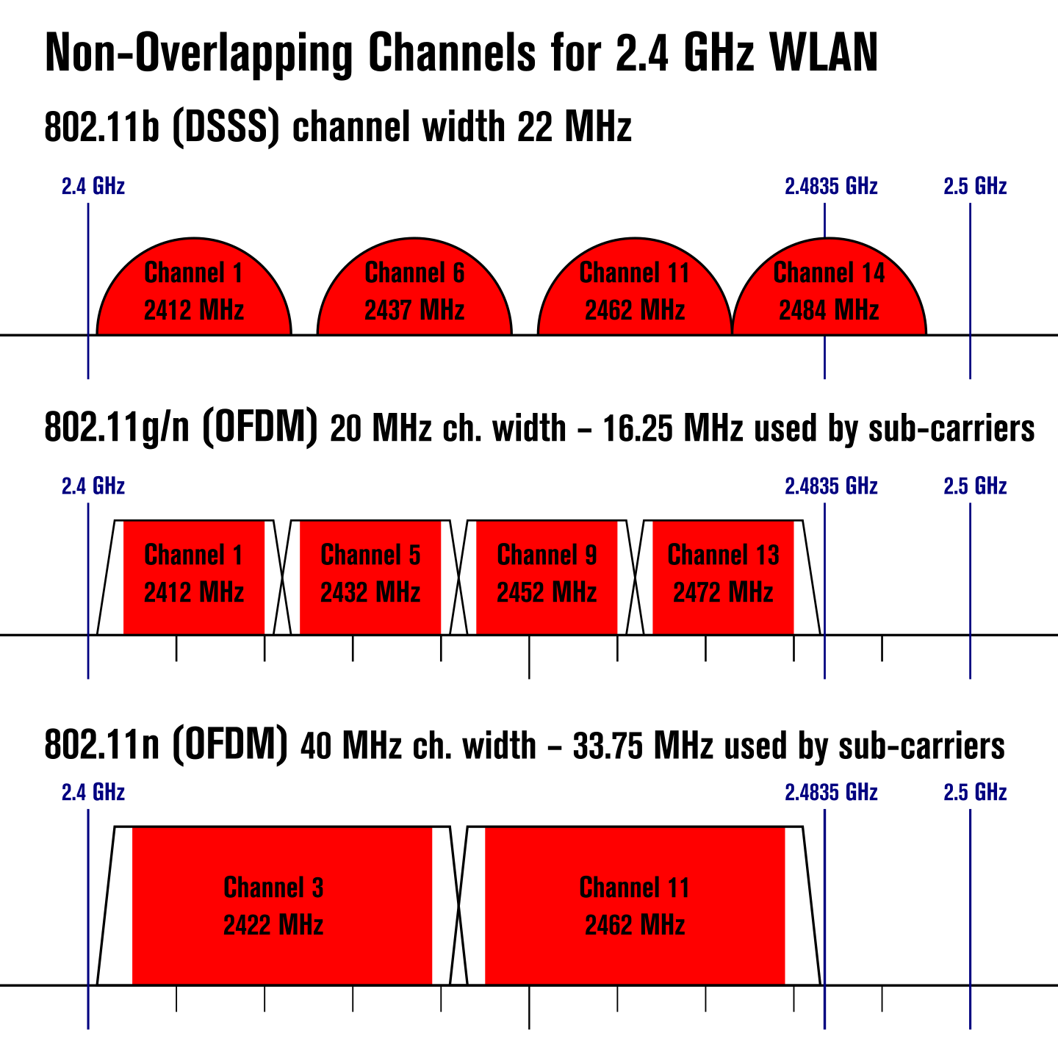

Slide 102
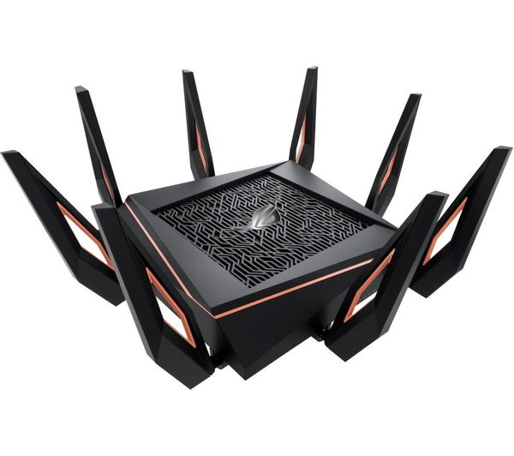
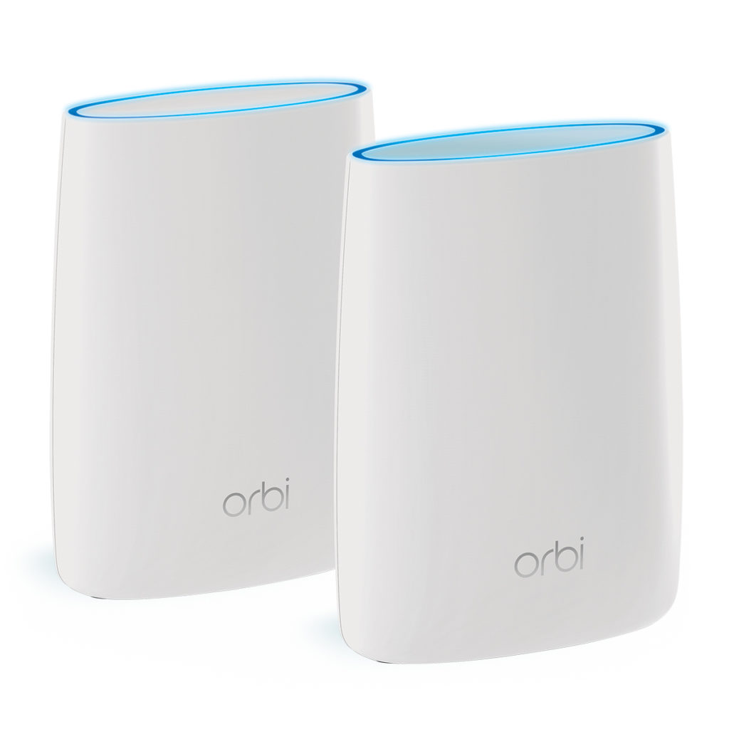
Wifi has been evolving!
Using dual band (2.4GHz + 5GHz), multiple channels, MIMO, Meshing WiFi
Outside this introduction but the state of the art is very fast and very flexible

Slide 103
CSMA/CA and RTS/CTS
sender
receiver
sender
receiver
RTS
data
CTS
data
ACK
ACK
RTS/CTS
helps with hidden terminal
good for high-traffic Access Points
often turned on/off dynamically
Without RTS/CTS
lower latency -> faster!
reduces wasted b/w
if the Pr(collision) is low
good for when net is small and not weird
eg no hidden/exposed terminals
Notes:
103

Slide 104
CSMA/CD vs CSMA/CA (without RTS/CTS)
CD Collision Detect
CA Collision Avoidance
wired – listen and talk
Listen for others
Busy? goto 1.
Send message (and listen)
Collision?
JAM
increase your BEB
sleep
goto 1.
wireless – talk OR listen
Listen for others
Busy? goto 1.
Send message
Wait for ACK (MAC ACK)
Got No ACK from MAC?
increase your BEB
sleep
goto 1.

Slide 105
802.11: advanced capabilities
power management
node-to-AP: “I am going to sleep until next beacon frame”
AP knows not to transmit frames to this node
node wakes up before next beacon frame
beacon frame: contains list of mobiles with AP-to-mobile frames waiting to be sent
node will stay awake if AP-to-mobile frames to be sent; otherwise sleep again until next beacon frame

Slide 106
Personal area networks: Bluetooth
TDM, 625 μsec sec. slot
FDM: sender uses 79 frequency channels in known, pseudo-random order slot-to-slot (spread spectrum)
other devices/equipment not in piconet only interfere in some slots
parked mode: clients can “go to sleep” (park) and later wakeup (to preserve battery)
bootstrapping: nodes self-assemble (plug and play) into piconet
C
P
P
radius of
coverage
M
C
P
C
P
M
master device
client device
parked device (inactive)
C
P

Slide 107
Summary of MAC protocols
channel partitioning, by time, frequency or code
Time Division (TDMA), Frequency Division (FDMA), Code Division (CDMA)
random access (dynamic),
ALOHA, S-ALOHA, CSMA, CSMA/CD
carrier sensing: easy in some technologies (wire), hard in others (wireless)
CSMA/CD used in (old-style, coax) Ethernet, and PowerLine
CSMA/CA used in 802.11
taking turns
polling from central site, token passing
Bluetooth, FDDI, IBM Token Ring

Slide 108
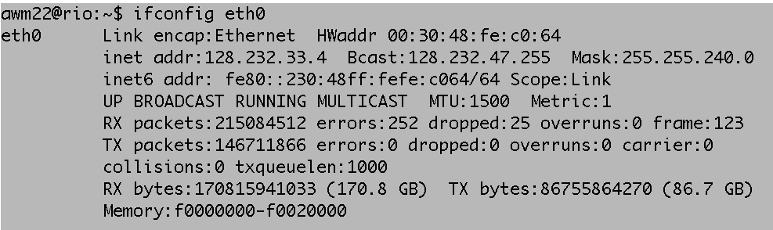
MAC Addresses
MAC (or LAN or physical or Ethernet) address:
function: get frame from one interface to another physically-connected interface (same network)
48 bit MAC address (for most LANs)
burned in NIC ROM, nowadays usually software settable and set at boot time

Slide 109
LAN Address (more)
MAC address allocation administered by IEEE
manufacturer buys portion of MAC address space (to assure uniqueness)
analogy:
(a) MAC address: like a National Insurance Number
(b) IP address: like a postal address
MAC flat address ➜ portability
can move LAN card from one LAN to another
IP hierarchical address NOT portable
address depends on IP subnet to which node is attached

Slide 110
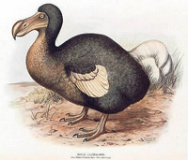
Hubs
… physical-layer (“dumb”) repeaters:
bits coming in one link go out all other links at same rate
all nodes connected to hub can collide with one another
no frame buffering
no CSMA/CD at hub: host NICs detect collisions
Collision Domain
in CSMA/CD speak
Co-ax or twisted pair
hub

Slide 111
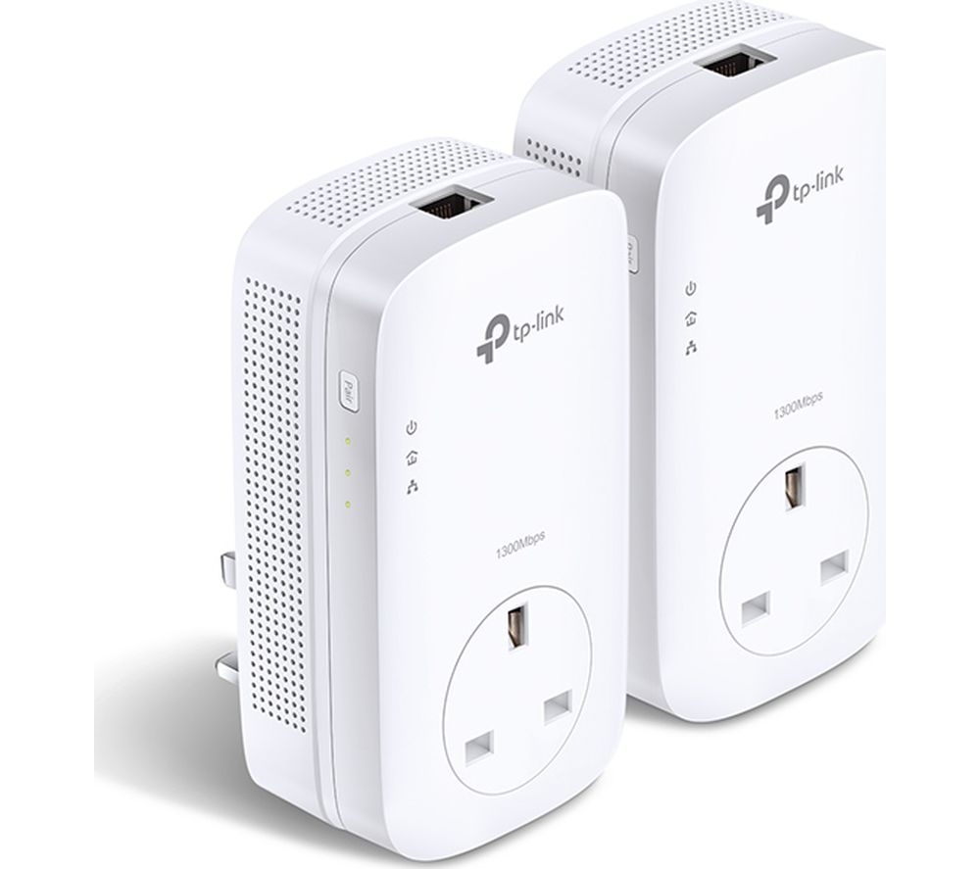
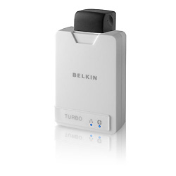
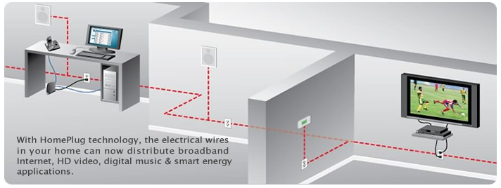
CSMA in our home
Home Plug Powerline Networking….

Slide 112
Home Plug and similar Powerline Networking….
Collision Domain
in CSMA speak
To secure network traffic on a specific HomePlug network, each set of adapters use an encryption key common to a specific HomePlug network

Slide 113
Switch (example: Ethernet Switch)
link-layer device: smarter than hubs, take active role
store, forward Ethernet frames
examine incoming frame’s MAC address, selectively forward frame to one-or-more outgoing links when frame is to be forwarded on segment, uses CSMA/CD to access segment
transparent
hosts are unaware of presence of switches
plug-and-play, self-learning
switches do not need to be configured
If you want to connect different physical media
(optical – copper – coax – wireless - ….)
you NEED a switch.
Why? (Because each link, each media access protocol is specialised)

Slide 114
Switch: allows multiple simultaneous transmissions
A
hosts have dedicated, direct connection to switch
switches buffer packets
Ethernet protocol used on each incoming link, but no collisions; full duplex
each link is its own collision domain
switching: A-to-A’ and B-to-B’ simultaneously, without collisions
not possible with dumb hub
C’
B
1
2
6
3
5
4
C
B’
A’
switch with six interfaces
(1,2,3,4,5,6)

Slide 115
Switch Table
A
Q: how does switch know that A’ reachable via interface 4, B’ reachable via interface 5?
A: each switch has a switch table, each entry:
(MAC address of host, interface to reach host, time stamp)
looks like a routing table!
Q: how are entries created, maintained in switch table?
something like a routing protocol?
C’
B
1
2
6
3
5
4
C
B’
A’
switch with six interfaces
(1,2,3,4,5,6)

Slide 116
Switch: self-learning
Source: A
Dest: A’
A
A A’
switch learns which hosts can be reached through which interfaces
when frame received, switch “learns” location of sender: incoming LAN segment
records sender/location pair in switch table
C’
B
1
2
6
3
5
4
C
B’
A’
MAC addr interface TTL
A
1
60
Switch table
(initially empty)

Slide 117
Switch: frame filtering/forwarding
When frame received:
1. record link associated with sending host
2. index switch table using MAC dest address
3. if entry found for destination then {
if dest on segment from which frame arrived then drop the frame
else forward the frame on interface indicated
}
else flood
forward on all but the interface
on which the frame arrived

Slide 118
Self-learning, forwarding: example
Source: A
Dest: A’
A
A A’
C’
B
frame destination unknown:
1
2
flood
6
3
A A’
A A’
A A’
A A’
A A’
5
4
destination A location known:
C
selective send
A’ A
B’
A’
MAC addr interface TTL
A
1
60
Switch table
(initially empty)
A’
4
60

Slide 119
Interconnecting switches
switches can be connected together
S₄
S₁
S₃
A
S₂
F
I
B
C
D
E
G
H
Q: sending from A to G - how does S₁ know to forward frame destined to F via S₄ and S₃?
A: self learning! (works exactly the same as in single-switch case – flood/forward/drop)

Slide 120
Flooding Can Lead to Loops
Flooding can lead to forwarding loops
E.g., if the network contains a cycle of switches
“Broadcast storm”

Slide 121

Solution: Spanning Trees
Ensure the forwarding topology has no loops
Avoid using some of the links when flooding
… to prevent loop from forming
Spanning tree
Sub-graph that covers all vertices but contains no cycles
Links not in the spanning tree do not forward frames
Graph Has Cycles!
Graph Has No Cycles!

Slide 122
What Do We Know?
“Spanning tree algorithm is an algorithm to create a tree out of a graph that includes all nodes with a minimum number of edges connecting to vertices.”
Shortest paths to (or from) a node form a tree
So, algorithm has two aspects :
Pick a root
Compute shortest paths to it
Only keep the links on shortest-path
Notes:
2020-2-7
Spanning tree is an algorithm to create a tree out of a graph that includes all nodes with a minimum number of edges connecting to vertices
The shortest path is defined as the sum of wights

Slide 123
Constructing a Spanning Tree
Switches need to elect a root
The switch w/ smallest identifier (MAC addr)
Each switch determines if each interface is on the shortest path from the root
Excludes it from the tree if not
Messages (Y, d, X)
From node X
Proposing Y as the root
And the distance is d
root
One hop
Three hops

Slide 124
Steps in Spanning Tree Algorithm
Initially, each switch proposes itself as the root
Switch sends a message out every interface
… proposing itself as the root with distance 0
Example: switch X announces (X, 0, X)
Switches update their view of the root
Upon receiving message (Y, d, Z) from Z, check Y’s id
If new id smaller, start viewing that switch as root
Switches compute their distance from the root
Add 1 to the distance received from a neighbor
Identify interfaces not on shortest path to the root
… and exclude them from the spanning tree
If root or shortest distance to it changed, “flood” updated message (Y, d+1, X)

Slide 125
Example From Switch #4’s Viewpoint
Switch #4 thinks it is the root
Sends (4, 0, 4) message to 2 and 7
Then, switch #4 hears from #2
Receives (2, 0, 2) message from 2
… and thinks that #2 is the root
And realizes it is just one hop away
Then, switch #4 hears from #7
Receives (2, 1, 7) from 7
And realizes this is a longer path
So, prefers its own one-hop path
And removes 4-7 link from the tree
1
3
5
2
#root
4
6
7

Slide 126
Example From Switch #4’s Viewpoint
Switch #2 hears about switch #1
Switch 2 hears (1, 1, 3) from 3
Switch 2 starts treating 1 as root
And sends (1, 2, 2) to neighbors
Switch #4 hears from switch #2
Switch 4 starts treating 1 as root
And sends (1, 3, 4) to neighbors
Switch #4 hears from switch #7
Switch 4 receives (1, 3, 7) from 7
And realizes this is a longer path
So, prefers its own three-hop path
And removes 4-7 Iink from the tree
1
3
5
#root
2
4
6
7

Slide 127
Robust Spanning Tree Algorithm
Algorithm must react to failures
Failure of the root node
Need to elect a new root, with the next lowest identifier
Failure of other switches and links
Need to recompute the spanning tree
Root switch continues sending messages
Periodically reannouncing itself as the root (1, 0, 1)
Other switches continue forwarding messages
Detecting failures through timeout (soft state)
If no word from root, times out and claims to be the root
Delay in reestablishing spanning tree is major problem
Work on rapid spanning tree algorithms…
Given a switch-tree of a given size, link length, speed of computation, …
How long does a failure take to rectify?

Slide 128
Weirder “Data Link Layer” Networks
VLAN VPN
Datacenter
“so you think your LAN has a lot of computers….”
Application
Application
Transport
Transport
Network
Network
Data Link (L2)
Transport
Data Link (L2)
Network
Physical
Data Link (L2)
Physical

Slide 129
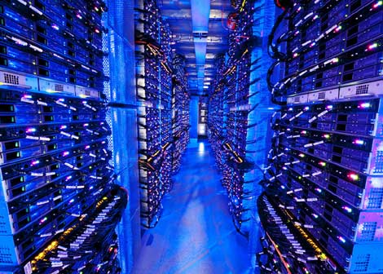
Datacenter networks
10’s to 100’s of thousands of hosts, often closely coupled, in close proximity:
e-business (e.g. Amazon)
content-servers (e.g., YouTube, Akamai, Apple, Microsoft)
search engines, data mining (e.g., Google)
challenges:
multiple applications, each serving massive numbers of clients
reliability
managing/balancing load, avoiding processing, networking, data bottlenecks
Inside a 40-ft Microsoft container, Chicago data center

Slide 130
Datacenter networks: network elements
Border routers
connections outside datacenter
Tier-1 switches
connecting to ~16 T-2s below
Tier-2 switches
connecting to ~16 TORs below
…
…
…
…
Top of Rack (TOR) switch
one per rack
40-100Gbps Ethernet to blades
…
…
…
…
Server racks
20- 40 server blades: hosts

Slide 131
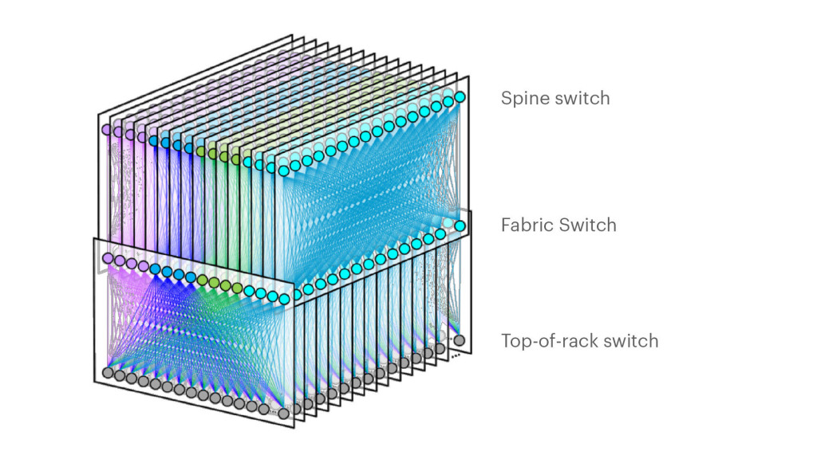
Datacenter networks: network elements
Facebook F16 data center network topology:
https://engineering.fb.com/data-center-engineering/f16-minipack/ (posted 3/2019)

Slide 132
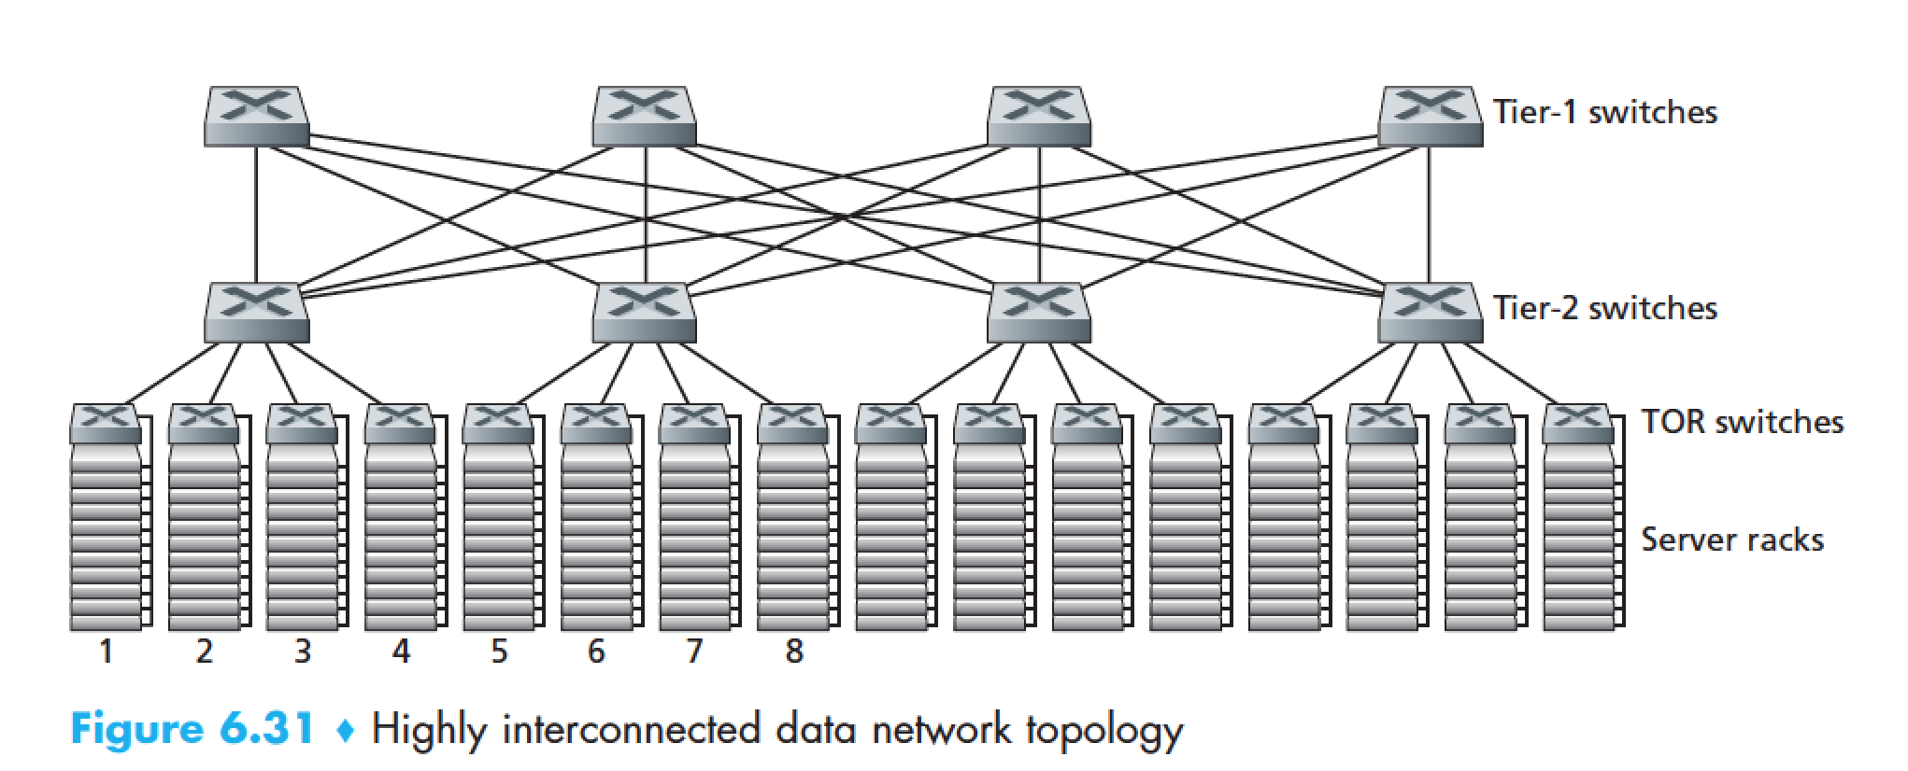
Datacenter networks: multipath
rich interconnection among switches, racks:
increased throughput between racks (multiple routing paths possible)
increased reliability via redundancy
9
10
11
12
13
14
15
16
two disjoint paths highlighted between racks 1 and 11

Slide 133
Datacenter networks: application-layer routing
Internet
load balancer: application-layer routing
receives external client requests
directs workload within data center
Load
balancer
…
…
…
…
returns results to external client (hiding data center internals from client)
…
…
…
…

Slide 134
Summary
principles behind data link layer services:
error detection, correction
sharing a broadcast channel: multiple access
link layer addressing
instantiation and implementation of various link layer technologies
Ethernet
switched LANS
WiFi
algorithms
Binary Exponential Backoff
Spanning Tree

